Slide 1
Knowledge Representation
Suppose I tell you the following...
  The Duck-Bill Platypus and the Echidna are the only two mammals that lay eggs.
  Only birds and mammals are warm blooded.
  “Susan”, my pet, is warm blooded, and has no feathers.
  All birds have feathers.
…and I ask you, can Susan lay eggs?

Slide 2
Knowledge Representation
A subarea of Artificial Intelligence concerned with understanding, designing, and implementing ways of representing information (knowledge) in computers so that programs (agents) or humans can use this information…
  • to derive new information that is implied by it,
Optionally
  • to converse with people in natural languages,
  • to decide what to do next
  • to plan future activities,
  • to solve problems in areas that normally require human expertise.
Stuart C. Shapiro

Slide 3
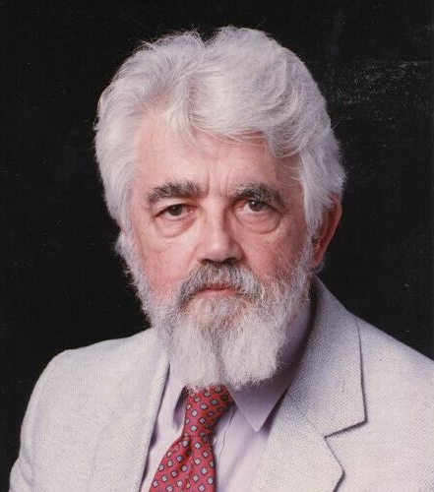
Knowledge Representation
a program has common sense if it automatically deduces for itself a sufficiently wide class of immediate consequences of anything it is told and what it already knows. . . In order for a program to be capable of learning something it must first be capable of being told it.
John McCarthy, “Programs with Common Sense”, 1959.
(He invented the term Artificial Intelligence)

Slide 4
Knowledge Representation
We would like to build a system, that we could TELL a set of facts/rules. This system we call a Knowledge Base (KB).
At some point in the future we would like to be able to ASK the Knowledge Base questions, and receive correct answers.
For simplicity we assume that the knowledge is represented as, and the questions are phrased as, true or false questions. For example we can’t ask
  “what class is susan?”
instead we can ask
  “susan a amphibian?”
  “susan a bird?”
  etc

Slide 5
Examples of Knowledge Bases
KB
If you are taken a blood thinner, do not also take aspirin.
Being a male, means you a NOT a female.
If you have given birth, it means you are a female.
Apixaban is a blood thinner
Dabigatran is a blood thinner

Slide 6

Examples of Knowledge Bases
TELL
Paul is a man
Paul is taking aspirin for headaches
Paul is 56 year old
KB
KB
If you are taken a blood thinner, do not also take aspirin.
Being a male, means you a NOT a female.
If you have given birth, it means you are a female.
Apixaban is a blood thinner
Dabigatran is a blood thinner
If you are taken a blood thinner, do not also take aspirin.
Being a male, means you a NOT a female.
If you have given birth, it means you are a female
Apixaban is a blood thinner
Dabigatran is a blood thinner
Paul is male
Paul is 56
Paul is taking aspirin

Slide 7
Examples of Knowledge Bases
ASK
TELL
Is it OK to give Paul Apixaban?
Paul is a man
Paul is taking aspirin for headaches
Paul is 56 year old
KB
KB
KB
If you are taken a blood thinner, do not also take aspirin.
Being a male, means you a NOT a female.
If you have given birth, it means you are a female.
Apixaban is a blood thinner
Dabigatran is a blood thinner
If you are taken a blood thinner, do not also take aspirin.
Being a male, means you a NOT a female.
If you have given birth, it means you are a female
Apixaban is a blood thinner
Dabigatran is a blood thinner
Paul is male
Paul is 56
Paul is taking aspirin
If you are taken a blood thinner, do not also take aspirin.
Being a male, means you a NOT a female.
If you have given birth, it means you are a female
Apixaban is a blood thinner
Dabigatran is a blood thinner
Paul is male
Paul is 56
Paul is taking aspirin

Slide 8
“what it already knows”
“it must first be capable of being told”
“automatically deduces for itself …consequences”
[McCarthy ’59]
Is it OK to give Paul Apixaban?
Paul is a man
Paul is taking aspirin for headaches
Paul is 56 year old
KB
KB
KB
If you are taken a blood thinner, do not also take aspirin.
Being a male, means you a NOT a female.
If you have given birth, it means you are a female.
Apixaban is a blood thinner
Dabigatran is a blood thinner
If you are taken a blood thinner, do not also take aspirin.
Being a male, means you a NOT a female.
If you have given birth, it means you are a female
Apixaban is a blood thinner
Dabigatran is a blood thinner
Paul is male
Paul is 56
Paul is taking aspirin
If you are taken a blood thinner, do not also take aspirin.
Being a male, means you a NOT a female.
If you have given birth, it means you are a female
Apixaban is a blood thinner
Dabigatran is a blood thinner
Paul is male
Paul is 56
Paul is taking aspirin

Slide 9
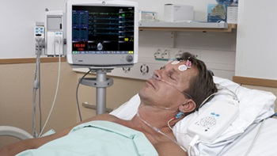
An important point: The TELL could come from a sensor, not a human
Paul has a fever
KB
KB
KB
If you are taken a blood thinner, do not also take aspirin.
Being a male, means you a NOT a female.
If you have given birth, it means you are a female.
Apixaban is a blood thinner
Dabigatran is a blood thinner
If you are taken a blood thinner, do not also take aspirin.
Being a male, means you a NOT a female.
If you have given birth, it means you are a female
Apixaban is a blood thinner
Dabigatran is a blood thinner
Paul is male
Paul is 56
Paul is taking aspirin
If you are taken a blood thinner, do not also take aspirin.
Being a male, means you a NOT a female.
If you have given birth, it means you are a female
Apixaban is a blood thinner
Dabigatran is a blood thinner
Paul is male
Paul is 56
Paul is taking aspirin

Slide 10
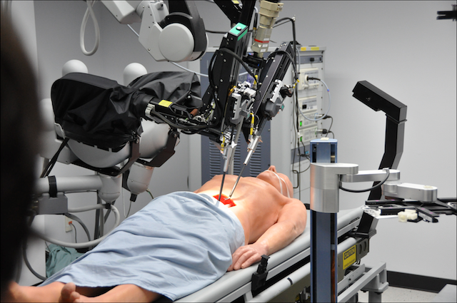
An important point: The ASK could come from robot/bot, not a human
Is it OK to give Paul Apixaban?
KB
KB
KB
If you are taken a blood thinner, do not also take aspirin.
Being a male, means you a NOT a female.
If you have given birth, it means you are a female.
Apixaban is a blood thinner
Dabigatran is a blood thinner
If you are taken a blood thinner, do not also take aspirin.
Being a male, means you a NOT a female.
If you have given birth, it means you are a female
Apixaban is a blood thinner
Dabigatran is a blood thinner
Paul is male
Paul is 56
Paul is taking aspirin
If you are taken a blood thinner, do not also take aspirin.
Being a male, means you a NOT a female.
If you have given birth, it means you are a female
Apixaban is a blood thinner
Dabigatran is a blood thinner
Paul is male
Paul is 56
Paul is taking aspirin

Slide 11
Another Example of Knowledge Base
NELL: Never-Ending Language Learning at CMU
Every day for the last 9 years, NELL reads the web, and TELLS its knowledge base new “facts” it has learned/
http://rtw.ml.cmu.edu/rtw/

Slide 12
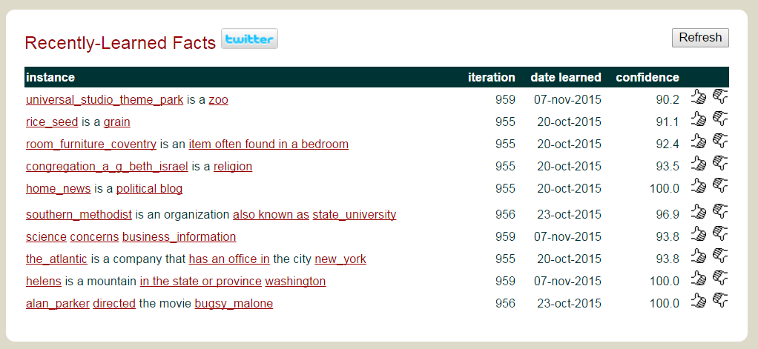

Slide 13
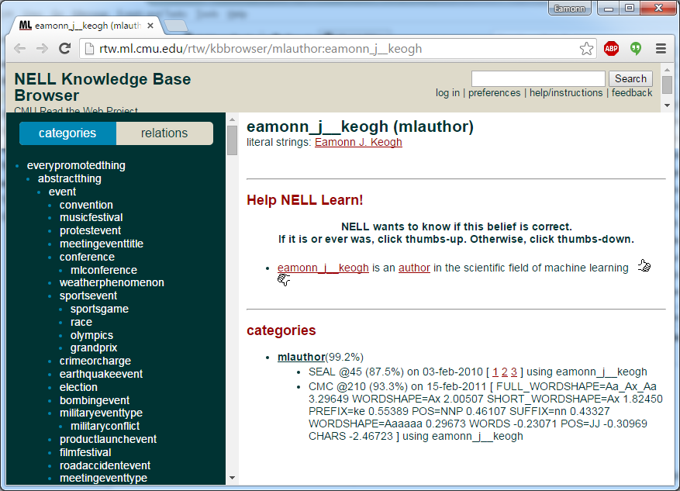

Slide 14
Knowledge Representation
More concretely, if we collect all our facts into a knowledge base KB, and we later want to know if a fact P is true. We will try to show that given the facts in our database, P must be true. We write this as
KB |- P
Read as KB entails P

Slide 15

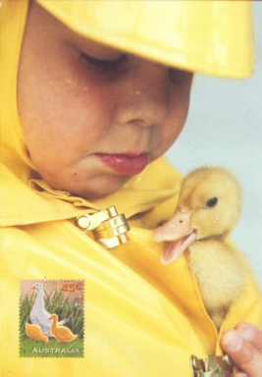
What do we need to do? I
We need to create a language to represent knowledge in our KB. This language should be
Expressive.
Unambiguous. “I saw her duck”
Context independent.
Compositional.

Slide 16
What do we need to do? II
We need an algorithm to answer the questions we might ASK.
The algorithm should be
Sound (only true facts are derived)
Complete (all true facts can be derived)
Efficient (we call ask a question and get an answer in reasonable time/space)

Slide 17
What language should we use?
Natural language, ie English, ASL, Cantonese. Too ambiguous.
Programming Language, ie C++, Lisp, Java. Not very expressive.
We will use logic! Actually there are many different logics.
We will start by considering
Propositional Logic. We will find that has some drawbacks so we will consider the more general
Predicate Logic. This too, has limitations, so we will consider the more general
First-Order Logic.
(we stop here, but…)
First-Order Logic
Propositional Logic
Predicate Logic

Slide 18
A logic language consists of semantics and syntax
Semantics: What the sentences mean.
Syntax: How legal sentences can be assembled.

Slide 19
Propositional Logic: Syntax I
Vocabulary
A set of propositional symbols
P, Q, R, ….
A set of logical connectives
∧, ∨ , ¬ , ⇒, ⇔
∧ (and) ∨ (or) ¬(not) ⇒ (implication) ⇔ (equivalence)
Parenthesis (for grouping)
( )
Logical constants
True, False

Slide 20
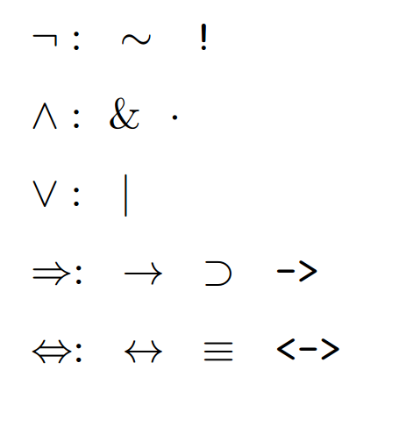
Propositional Logic: Syntax I
Vocabulary
Some people use alternative notation..

Slide 21
Propositional Logic: Syntax II
Each symbol P, Q, R etc is a (atomic) sentence
Both True and False are (atomic) sentences
A sentence wrapped in parentheses is a sentence
If α and β are sentences, then so are
  α ∧ β conjunction
  α ∨ β disjunction
  ¬α negation
  α ⇒ β implication
  α ⇔ β equivalence
The above are complex sentences
Precedence is ¬ , ∧ , ∨ , ⇒ , ⇔

Slide 22
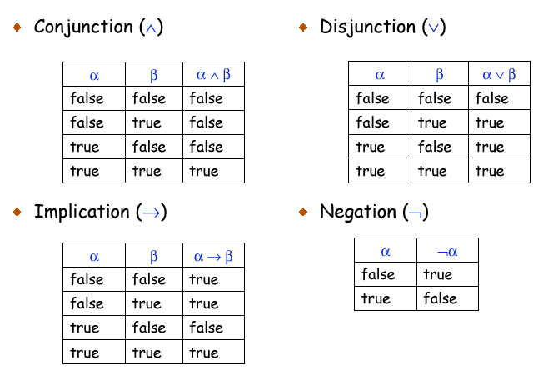
Truth Tables

Slide 23
Truth Tables
If Eamonn is female, then the moon is green TRUE!
If Eamonn is female, then the moon is white TRUE!
If Eamonn is male, then the moon is pink FALSE
If Eamonn is male, then the moon is white TRUE!

Slide 24
Sample Sentences
P (P ∧ ¬ Q) ⇒ R
True (P ∧ Q) ⇔ (Q ∧ P)
(P ∧ Q) (P ∨ R )
What do the sentences mean?
The meaning depends on user defined semantics. If P is defined as “it is hot” and Q is defined as “it is raining”, then
P means it is hot
P ∨ Q means either it is hot or it is raining (or both)
¬Q means that it is not raining

Slide 25
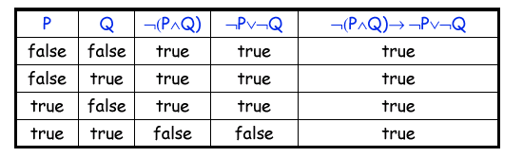
An inference procedure for proposition logic
Suppose we want to prove ¬(P ∧ Q) ⇒ (P ∨ ¬Q)
Construct a truth table, if ¬(P ∧ Q) ⇒ (P ∨ ¬Q) is true for all values of P and Q, then we have proved it.
For any sentence, no matter how complex, we can always proved or disproved it this way. In other words, truth table construction is complete.

Slide 26
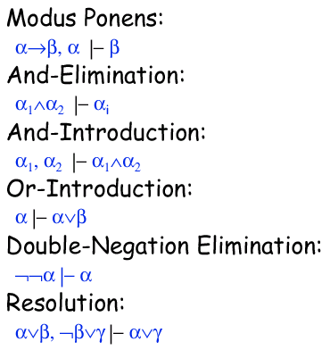
Inference Rules
Some patterns of reasoning are so common that instead of creating a truth table each time we see them, we can just establish their truth once, then reuse the pattern in any situation.
(As we shall see, these are search operators )

Slide 27
Irish ⇒ Hot, Irish |- Hot
If we know Irish implies hot is true, and know Irish is true, we can infer Hot is true. Read as
Irish implies Hot, Irish, Therefore Hot
Irish ∧ Blue |- Blue
If we know Irish and Blue is true, we can infer that Blue is true. Read as
Irish and Blue, Therefore Blue
Irish, Red |- Irish ∧ Red
If we know Irish is true, and we know Red is true, we can infer that Irish and Red is true. Read as
Irish , Red, Therefore Irish and Red

Slide 28
Irish |- Irish ∨ Green
If we know Irish is true, then we know that Irish or Green is true. Read as
Irish, Therefore Irish or Green
¬¬Irish |- Irish
If we know not not Irish is true, we can infer that Irish is true. Read as
Not not Irish, Therefore Irish
Irish ∨ Red, ¬ Red ∨ Fast |- Irish ∨ Fast
If we know Irish or Red is true, and we know not Red or Fast is true, we can infer that Irish or Fast must be true. Read as
Irish or Red, not Red or Fast, Therefore Irish or Fast

Slide 29
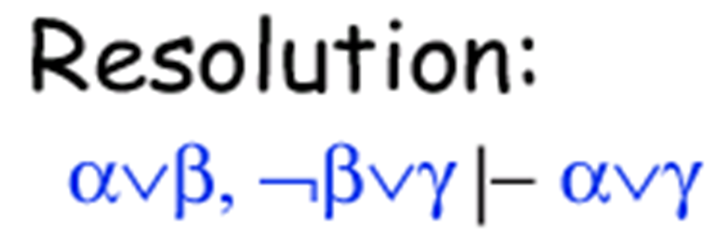
Suppose you know that you are going to fail or pass CS 205. Further, since this is the only class you need to graduate, you know that you are going to either not pass the class or graduate on time.
Then you can derive the new fact that you will either not pass or you graduate on time.
Fail or Pass, not Pass or GraduateOnTime
Therefore Fail or GraduateOnTime
F ∨ P, ¬P ∨ G
F ∨ G
F Fail
P Pass
G Graduate on time

Slide 30
Suppose my knowledge base consists of the facts
S ∧ T ⇒ ¬(¬P ∧ R)
¬¬S
T
R
In other words,
    I TELLed my KB T
    I TELLed my KB R
    I TELLed my KB ¬¬S
    I TELLed my KB S ∧ T ⇒ ¬(¬P ∧ R)
A week later, my boss asks me “Find out if P is True”
It might be that P means “Madrid is the Capital of Spain”. However, for our purposes it does not matter.
All we want to know is this: Does our KB entail P?
So we are going to ASK: KB |- P

Slide 31
Suppose my knowledge base consists of the facts
S ∧ T ⇒ ¬(¬P ∧ R)
¬¬S
T
R
We might have gotten lucky, suppose my boss asks me “Find out if T is True”
Here all we want to know is this: Does our KB entail T?
If we look in the KB we see T, so yes! KB |- T
We are done with this ASK.
But we were asked instead about P, and P, all by itself, is not alone in our KB. We will have to try inference.

Slide 32
Inference
S ∧ T ⇒ ¬(¬P ∧ R)
¬¬S
T
R
We can take any fact or combination of facts that are currently in our KB, and use any legal operator(s) to derive new facts.
So if my KB contains ¬¬S then I can infer S by double negation elimination.
Likewise if my KB contains T and it contains R, then I can infer T ∧ R by and-introduction.
Can inference help us solve the original problem? Recall our boss asked “Find out if P is True”

Slide 33
Suppose my knowledge base consists of the facts
S ∧ T ⇒ ¬(¬P ∧ R)
¬¬S
T
R
And I need to prove P is entailed. I can use the rules of inference to do this..
List the facts
S ∧ T ⇒ ¬(¬P ∧ R) , ¬¬S , T

Slide 34
Suppose my knowledge base consists of the facts
S ∧ T ⇒ ¬(¬P ∧ R)
¬¬S
T
R
And I need to prove P is entailed. I can use the rules of inference to do this..
S ∧ T ⇒ ¬(¬P ∧ R) , ¬¬S , T And-Introduction
S ∧ T ⇒ ¬(¬P ∧ R) , ¬¬ S ∧ T

Slide 35
Suppose my knowledge base consists of the facts
S ∧ T ⇒ ¬(¬P ∧ R)
¬¬S
T
R
And I need to prove P is entailed. I can use the rules of inference to do this..
S ∧ T ⇒ ¬(¬P ∧ R) , ¬¬S , T And-Introduction
S ∧ T ⇒ ¬(¬P ∧ R) , ¬¬ S ∧ T Double Negation Elimination
S ∧ T ⇒ ¬(¬P ∧ R) , (S ∧ T)

Slide 36
Suppose my knowledge base consists of the facts
S ∧ T ⇒ ¬(¬P ∧ R)
¬¬S
T
R
And I need to prove P is entailed. I can use the rules of inference to do this..
S ∧ T ⇒ ¬(¬P ∧ R) , ¬¬S , T And-Introduction
S ∧ T ⇒ ¬(¬P ∧ R) , ¬¬ S ∧ T Double Negation Elimination
S ∧ T ⇒ ¬(¬P ∧ R) , (S ∧ T) Modus ponens
¬(¬P ∧ R)

Slide 37
Suppose my knowledge base consists of the facts
S ∧ T ⇒ ¬(¬P ∧ R)
¬¬S
T
R
And I need to prove P is entailed. I can use the rules of inference to do this..
List some facts
S ∧ T ⇒ ¬(¬P ∧ R) , ¬¬S , T And-Introduction
S ∧ T ⇒ ¬(¬P ∧ R) , ¬¬ S ∧ T Double Negation Elimination
S ∧ T ⇒ ¬(¬P ∧ R) , (S ∧ T) Modus ponens
¬(¬P ∧ R) And-Elimination
¬¬P

Slide 38
Suppose my knowledge base consists of the facts
S ∧ T ⇒ ¬(¬P ∧ R)
¬¬S
T
R
And I need to prove P is entailed. I can use the rules of inference to do this..
List some facts
S ∧ T ⇒ ¬(¬P ∧ R) , ¬¬S , T And-Introduction
S ∧ T ⇒ ¬(¬P ∧ R) , ¬¬ S ∧ T Double Negation Elimination
S ∧ T ⇒ ¬(¬P ∧ R) , (S ∧ T) Modus ponens
¬(¬P ∧ R) And-Elimination
¬¬P Double Negation Elimination
P
So the rules of inference allow us to (sometimes) bypass having to build truth tables.

Slide 39
S ∧ T ⇒ ¬(¬P ∧ R)
¬¬S
T
R
This is search!
S ∧ T ⇒ ¬(¬P ∧ R)
¬¬S
T
R
¬¬R
S ∧ T ⇒ ¬(¬P ∧ R)
¬¬S
T
R
R ∧ T
S ∧ T ⇒ ¬(¬P ∧ R)
¬¬S
T
R
S
S ∧ T ⇒ ¬(¬P ∧ R)
¬¬S
T
R
¬¬S ∧ R
S ∧ T ⇒ ¬(¬P ∧ R)
¬¬S
T
R
¬¬R
….
….
P

Slide 40
Important Note
S ∧ T ⇒ ¬(¬P ∧ R)
¬¬S
T
R
Suppose that some sentence is NOT entailed by the KB. That does NOT mean it is not true?
For example, Consider the sentence B , where B stand for “there is a number greater than five”
Is B entailed by our KB? Clearly not. This just means that we cannot say anything about B

Slide 41
So far the news is good. We can represent facts in Propositional Logic, and we have a sound and complete procedure for inference. But Propositional Logic has some weaknesses...
The size of the truth tables grows exponentially. So we may run out of space and time before we can answer a question.
Suppose I want to encode the fact that all men are mammals, I have no choice but to list that fact for each individual man in my knowledge base
  P means Paul is a mammal
  Q means Quentin is a mammal
  R means Robert is a mammal
  S means Steve is a mammal
Etc etc
What we really need is a compact way represent these kinds of facts….

